Slide 1
Phase congruency for Edge Detection of touching objects
Phase III Final Project Presentation
Sequoia Andrade

Slide 2
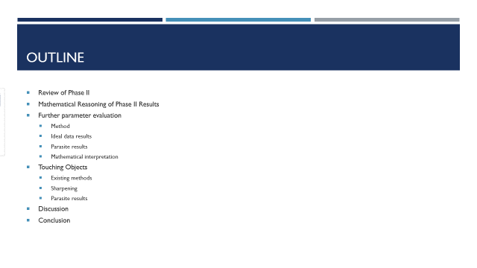

Outline
Review of Phase II
Mathematical Reasoning of Phase II Results
Further parameter evaluation
Method
Ideal data results
Parasite results
Interpretation
Touching Objects
Existing methods
Sharpening
Parasite results
Discussion
Conclusion

Slide 3
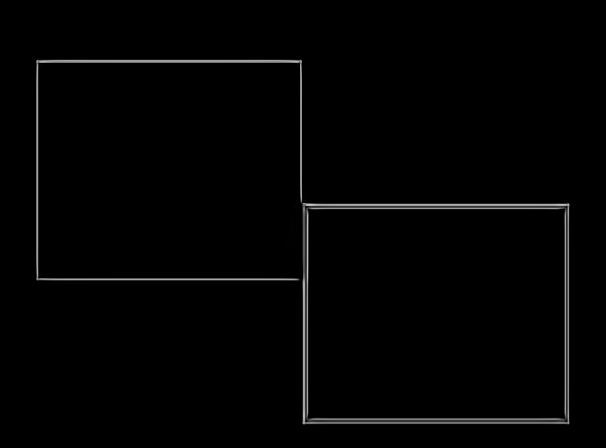
Review of Phase II
In phase II:
Created a dataset consisting of five experimental conditions with six object placements in each experiment
Experimental conditions varied on object shape, edge type, and number of objects
Identified best parameters for each experiment
Analyzed the impact of experimental conditions on edge degradation
Feedback:
Mathematically describe results
Investigate parameter stability
Connect to touching objects
Figure 1 shows an example output from Phase II

Slide 4
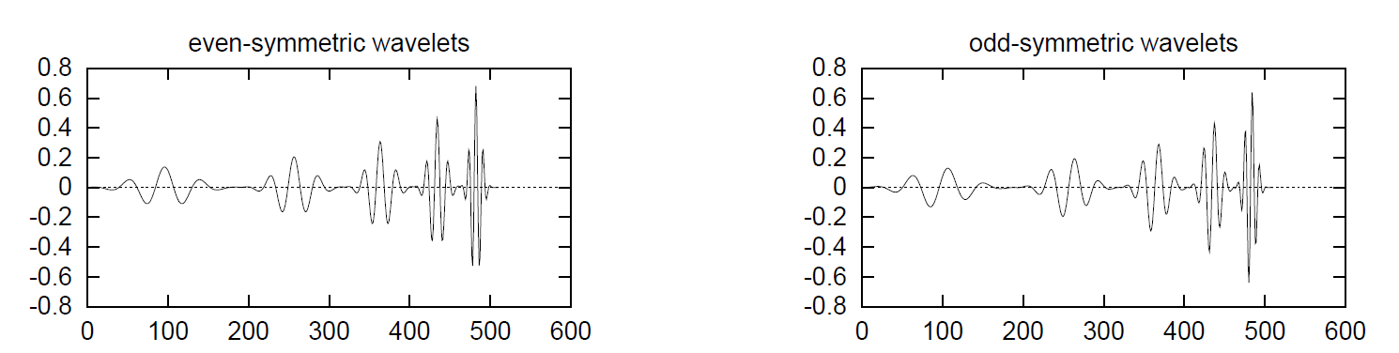
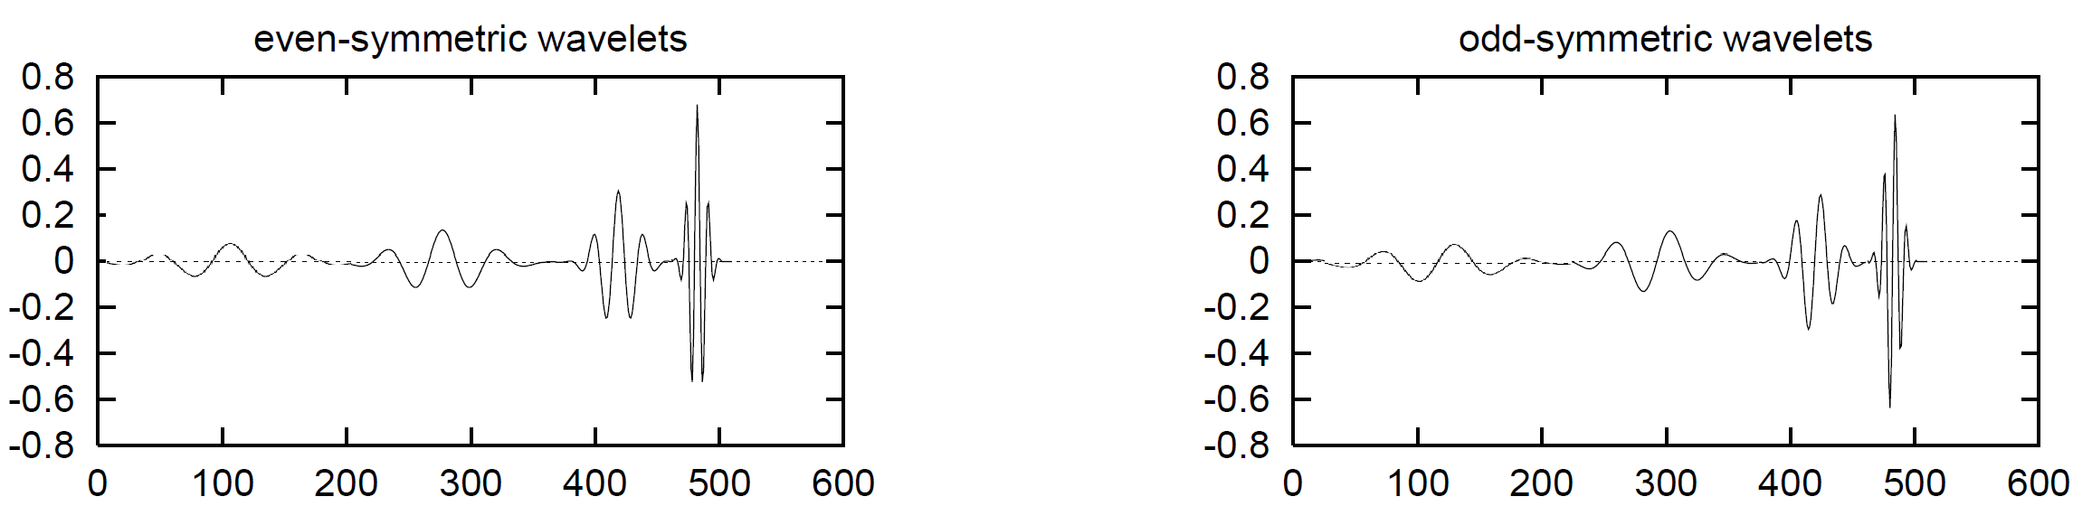
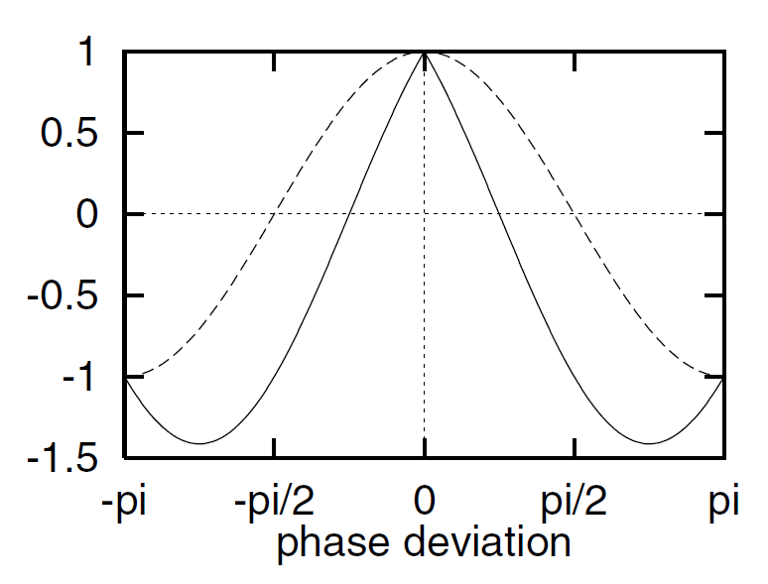

Mathematical Reasoning
$$PC\left(x\right)= \frac{\sum_{n}{{W(x) (A_{n}(x){∆φ}_{n}(x) −T)}^{+}}}{\sum{A_{n}}+ε}$$
Mult: worse results when the values are larger
Large values result in larger multiples of wavelets which results in global rather than local feature detection
Deviation gain: worse results when larger
Related to the phase deviation, sharpens the edges
Large values sharpen the edges to much resulting in loss of information
Figure 3 shows the phase deviation, where larger values increase the slope, From [2]
Figure 2a (top) shows a bank of wavelets with default mult, while Figure 2b (bottom) shows a bank of wavelets with larger mult, adapted from [1]

Slide 5
Further Parameter Tuning

Slide 6
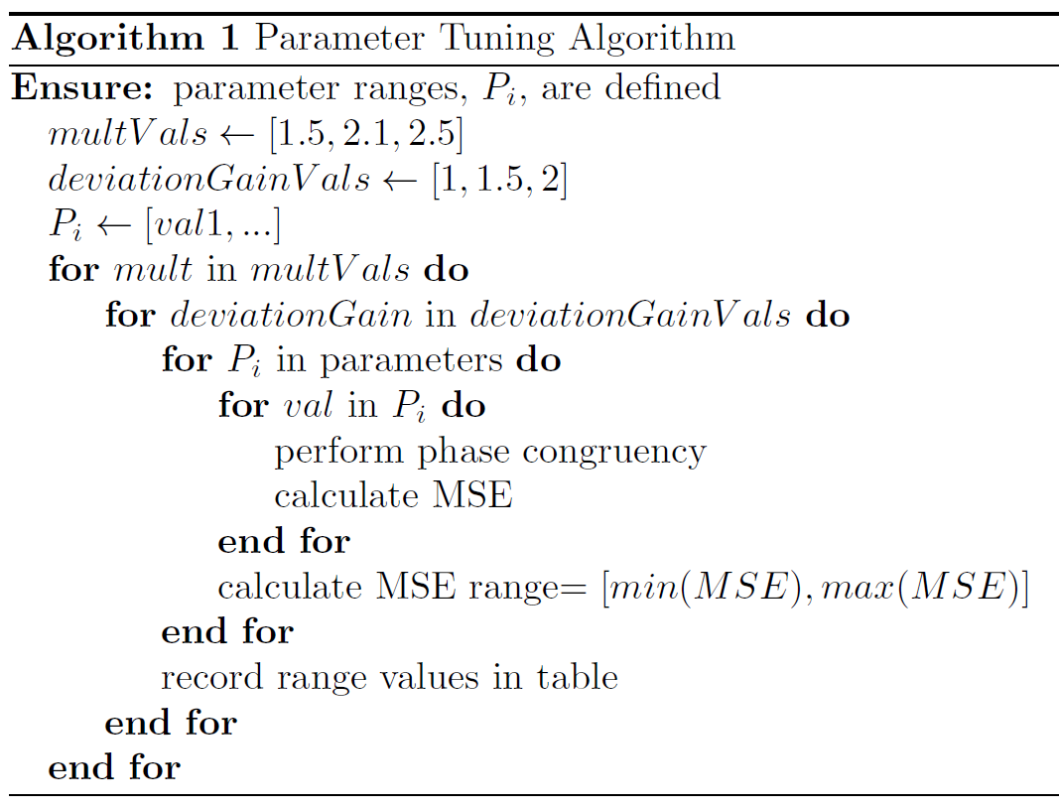
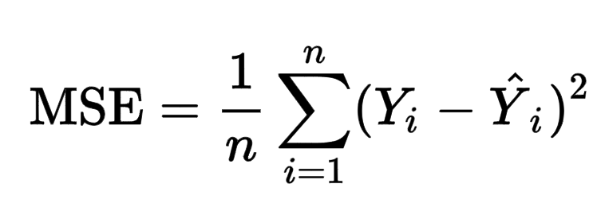
Further Parameter Evaluation: set up
Table 1: Parameters, definitions, and ranges. Default values are bolded, parameters from phase II are bold and italic.
Parameter | Definition | Range
Nscale | number of filters/scales to use to calculate PC | 3, 4, 5
minWaveLength | wavelength of smallest scale filter | 2, 3, 4
Mult | scaling factor between successive filters | 1.5, 2.1, 2.5
sigmaOnf | ratio of the standard deviation of the gaussian to the filter center frequency for the bank of filters | 0.45, 0.55, 0.65
K | number of standard deviations noise energy must be above | 1, 3, 10, 15
cutOff | fractional measure of frequency spread below which phase congruency values get penalized | 0.4, 0.5, 0.6
G | controls the sharpness of the transition in the sigmoid function used to weight phase congruency for frequency spread | 5, 10, 15
deviationGain | amplification to apply to the calculated phase deviation result, sharpens edges | 1, 1.5, 2
NoiseMethod | method for noise statistics (median, mode, none) | -2, -1, 1

Slide 7
Further Parameter Evaluation: Ideal Image Results
Table 2: Output MSE ranges for each parameter and combination of DeviationGain/Mult on Ideal Images. Each cell has (min, max) and the range of max-min
Smaller ranges indicate the parameter has minimal impact
Larger ranges indicate greater impact
Smaller Mult value consistently gives better MSE
Deviation gain is less consistent
No clear trends
Seems to impact the range
Nscale, k, and G tend to give the best MSE scores
Param | Deviation Gain=1 Mult=1.5 | Deviation Gain=1 Mult=2.1 | Deviation Gain=1 Mult=2.5 | Deviation Gain=1.5 Mult=1.5 | Deviation Gain=1.5Mult=2.1 | Deviation Gain=1.5Mult=2.5 | Deviation Gain=2 Mult=1.5 | Deviation Gain=2 Mult=2.1 | Deviation Gain=2 Mult=2.5
Nscale | 1.012-1.696, 0.68 | 1.012-1.703, 0.69 | 1.012-1.706, 0.69 | 1.012-1.693, 0.68 | 1.012-1.699, 0.69 | 1.012-1.711, 0.7 | 1.012-1.691, 0.68 | 1.012-1.704, 0.69 | 1.012-1.718, 0.71
minWaveLength | 1.012-1.704, 0.69 | 1.012-1.707, 0.69 | 1.012-1.709, 0.7 | 1.012-1.701, 0.69 | 1.012-1.704, 0.69 | 1.012-1.711, 0.7 | 1.012-1.697, 0.68 | 1.012-1.705, 0.69 | 1.012-1.714, 0.7
sigmaOnf | 1.014-1.697, 0.68 | 1.012-1.702, 0.69 | 1.012-1.708, 0.7 | 1.012-1.692, 0.68 | 1.012-1.704, 0.69 | 1.012-1.712, 0.7 | 1.012-1.69, 0.68 | 1.012-1.711, 0.7 | 1.012-1.718, 0.71
k | 1.016-1.686, 0.67 | 1.012-1.702, 0.69 | 1.012-1.703, 0.69 | 1.016-1.684, 0.67 | 1.012-1.697, 0.68 | 1.012-1.7, 0.69 | 1.012-1.683, 0.67 | 1.012-1.697, 0.68 | 1.012-1.704, 0.69
cutOff | 1.016-1.696, 0.68 | 1.012-1.705, 0.69 | 1.012-1.708, 0.7 | 1.016-1.691, 0.68 | 1.012-1.702, 0.69 | 1.012-1.71, 0.7 | 1.012-1.688, 0.68 | 1.012-1.706, 0.69 | 1.012-1.714, 0.7
G | 1.016-1.685, 0.67 | 1.012-1.703, 0.69 | 1.012-1.705, 0.69 | 1.016-1.685, 0.67 | 1.012-1.699, 0.69 | 1.012-1.704, 0.69 | 1.012-1.683, 0.67 | 1.012-1.698, 0.69 | 1.012-1.707, 0.69
Noise Method | 1.016-1.692, 0.68 | 1.012-1.704, 0.69 | 1.012-1.708, 0.7 | 1.016-1.69, 0.67 | 1.012-1.702, 0.69 | 1.012-1.706, 0.69 | 1.012-1.69, 0.68 | 1.012-1.703, 0.69 | 1.012-1.711, 0.7

Slide 8
Further Parameter Evaluation: Parasite Image Results
Best parameters:
DeviationGain = 1
Mult = 1.5
Other parameters are mostly stable, with minWaveLength, k, and the Noise Method having the greatest range
Consistent with ideal results for Mult value
Table 3: Output MSE ranges for each parameter and combination of DeviationGain/Mult on Parasite Images. Each cell has (min, max) and the range between the min and max
Param | Deviation Gain=1 Mult=1.5 | Deviation Gain=1 Mult=2.1 | Deviation Gain=1 Mult=2.5 | Deviation Gain=1.5 Mult=1.5 | Deviation Gain=1.5 Mult=2.1 | Deviation Gain=1.5 Mult=2.5 | Deviation Gain=2 Mult=1.5 | Deviation Gain=2 Mult=2.1 | Deviation Gain=2 Mult=2.5
Nscale | 0.048-0.093, 0.04 | 0.049-0.099, 0.05 | 0.049-0.099, 0.05 | 0.049-0.094, 0.04 | 0.049-0.099, 0.05 | 0.05-0.099, 0.05 | 0.049-0.095, 0.05 | 0.049-0.098, 0.05 | 0.05-0.098, 0.05
minWaveLength | 0.048-0.13, 0.08 | 0.049-0.099, 0.05 | 0.051-0.099, 0.05 | 0.049-0.124, 0.07 | 0.05-0.099, 0.05 | 0.051-0.099, 0.05 | 0.049-0.118, 0.07 | 0.05-0.099, 0.05 | 0.05-0.098, 0.05
sigmaOnf | 0.048-0.093, 0.04 | 0.05-0.098, 0.05 | 0.051-0.1, 0.05 | 0.048-0.094, 0.05 | 0.05-0.099, 0.05 | 0.051-0.1, 0.05 | 0.049-0.095, 0.05 | 0.05-0.099, 0.05 | 0.051-0.099, 0.05
k | 0.048-0.134, 0.09 | 0.05-0.099, 0.05 | 0.05-0.1, 0.05 | 0.049-0.127, 0.08 | 0.05-0.099, 0.05 | 0.05-0.099, 0.05 | 0.049-0.12, 0.07 | 0.05-0.099, 0.05 | 0.05-0.098, 0.05
cutOff | 0.048-0.092, 0.04 | 0.049-0.098, 0.05 | 0.051-0.099, 0.05 | 0.048-0.093, 0.04 | 0.05-0.099, 0.05 | 0.051-0.099, 0.05 | 0.049-0.093, 0.04 | 0.05-0.099, 0.05 | 0.051-0.099, 0.05
G | 0.048-0.092, 0.04 | 0.05-0.098, 0.05 | 0.051-0.099, 0.05 | 0.049-0.092, 0.04 | 0.05-0.099, 0.05 | 0.051-0.099, 0.05 | 0.049-0.093, 0.04 | 0.05-0.099, 0.05 | 0.051-0.098, 0.05
Noise Method | 0.048-0.264, 0.22 | 0.05-0.212, 0.16 | 0.051-0.15, 0.1 | 0.049-0.26, 0.21 | 0.05-0.157, 0.11 | 0.051-0.111, 0.06 | 0.049-0.253, 0.2 | 0.05-0.124, 0.07 | 0.051-0.102, 0.05

Slide 9
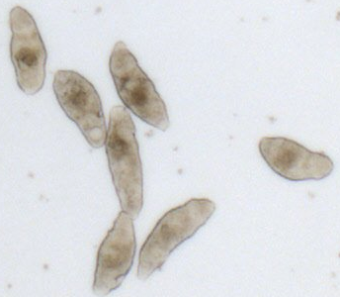
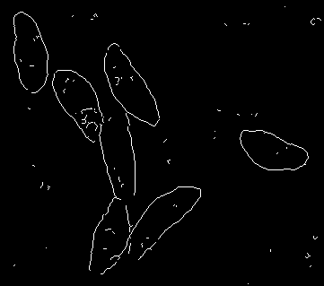
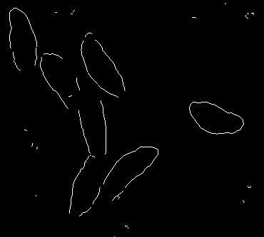
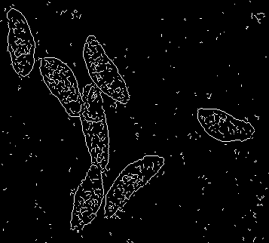
Interpretation
(a)
(b)
Larger mult values in 4(c) capture more global features
Smaller mult values in 4(d) capture
This is due to the effect on the wavelet bank
Touching parasites loose edges when using the more global method
Hence, tuning these parameters to capture local features could improve image segmentation when objects are touching
(c)
(d)
Figure 4: Comparison of input image (a), default method (b), worst parameters(c) and best parameters(d)

Slide 10
Touching Objects

Slide 11
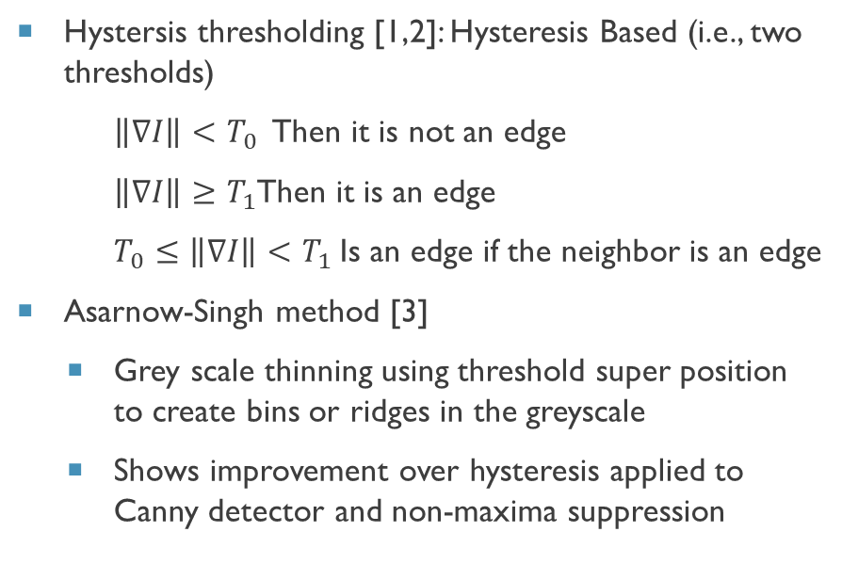
Touching Objects
Existing methods for defining edges of touching objects are centered on examining the difference between the edge and surrounding data
Existing methods are typically applied after the initial image segmentation
A natural next step would then be to investigate the impact of other edge defining methods
Proposed direction: Un-sharp masking [5] as a method to better define Mach Bands[4]
Hystersis thresholding [1,2]: Hysteresis Based (i.e., two thresholds)
$\left\|∇I\right\|<T_{0}$ Then it is not an edge
$\left\|∇I\right\|≥T_{1}$Then it is an edge
$T_{0}≤\left\|∇I\right\|<T_{1}$Is an edge if the neighbor is an edge
Asarnow-Singh method [3]
Grey scale thinning using threshold super position to create bins or ridges in the greyscale
Shows improvement over hysteresis applied to Canny detector and non-maxima suppression

Slide 12
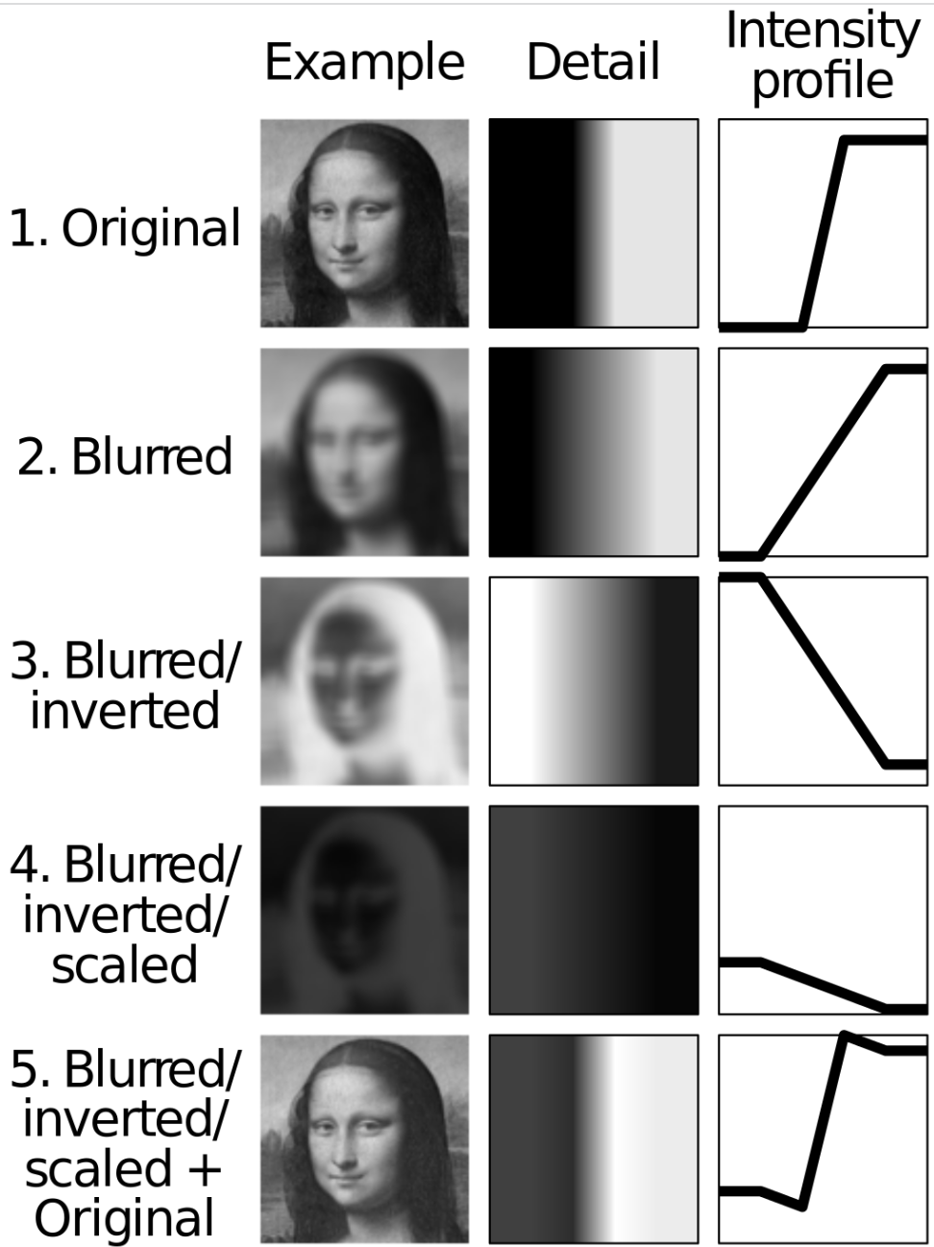
Touching Objects : sharpening
Mach Bands[4]:
Edges appear discontinuous to us, but may be more smooth in reality
Difference in colors are exaggerated in our perception – this is an illusion
Related to Asarnow-Singh gray scale thinning
Un-sharp masking [5]
Creates sharper edges/discontinuities and defines Mach bands
Relation to phase congruency
Adds more detail to an image, which can in turn add more frequencies to the Fourier transform and improve image segmentation
Applying post PC could help thin edges
Figure 5: demonstration of the Mach Band illusion from [4]
Figure 6: demonstration of unsharp masking from [5]

Slide 13
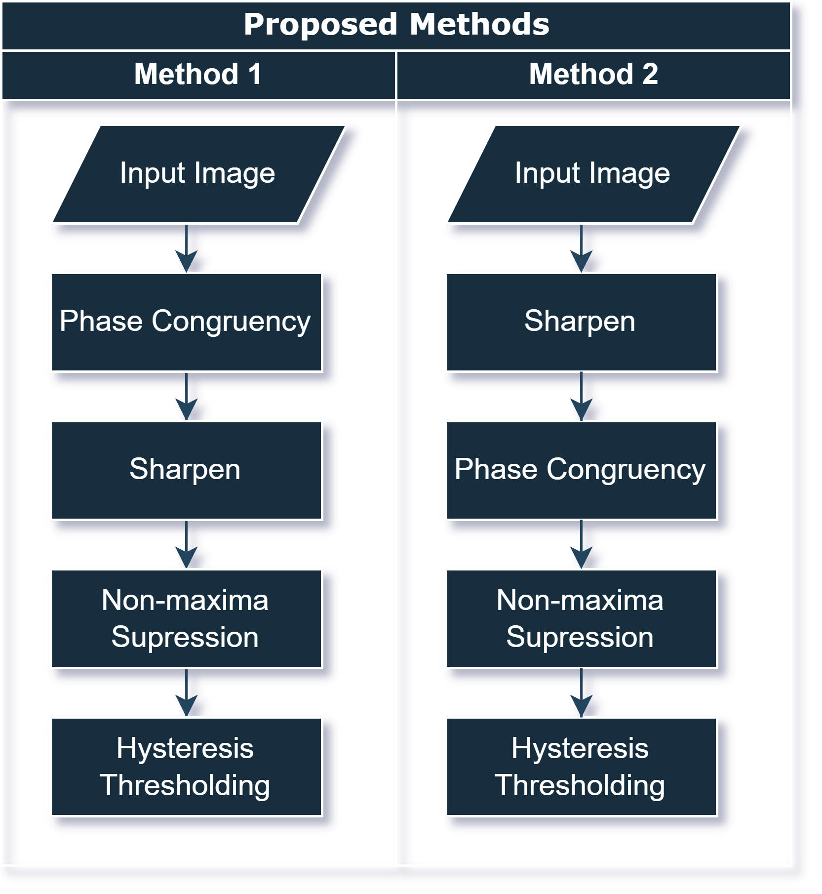
Touching Objects : Method
Does sharpening improve image segmentation when objects are touching when compared to traditional PC?
Where should Sharpening be applied in the pipeline?
Method 1 sharpens or thins the phase congruency output
Method 2 sharpens the original image prior to phase congruency
Control using regular phase congruency
Implementation:
MATLAB imsharpen function
Method of evaluation:
MSE
Figure 7: Method for integrating sharpening with phase congruency

Slide 14
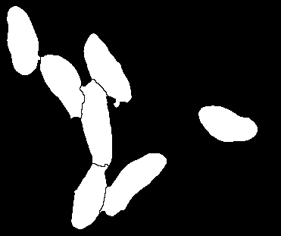
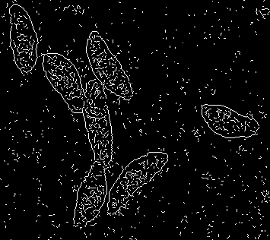
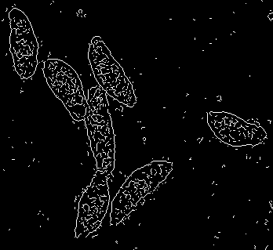
Touching Objects : Parasites
Table 4: Summary statistics of MSE for each method
(a)
(b)
Measure | Control | Method 1 | Method 2
Min | 0.0483 | 0.0495 | 0.0483
Median | 0.0649 | 0.0747 | 0.0628
Max | 0.0914 | 0.0919 | 0.0912
Mean | 0.0683 | 0.747 | 0.0666
Std dev | 0.0121 | 0.126 | 0.0120
(c)
(d)
Figure 8: Comparison of input image (a), Asarnow-Singh method (b), proposed method 1(c) and method 2(d)
(a)
(b)
Figure 9: Close up of proposed method 1(a) and method 2(b)

Slide 15
Discussion
Parameters should be considered when working with touching objects
Sharpening methods may not be as effective as existing methods for improving segmentation of touching objects
The added computation cost provides minimal benefits
MATLAB has complex methods for indexing arrays and specific requirements of datatypes stored in arrays
MATLAB tables can be difficult to work with
Trouble using raw MSE as a metric alone because the values are so small for images

Slide 16
Conclusion
Presented two main contributions:
Investigating parameter stability via parameter tuning on both ideal images and parasite images
Investigated the potential benefits and draw backs of implementing unsharp masking in the phase congruency pipeline
Parameter results
Smaller wavelet multipliers tend to give better results around touching objects
Unsharp masking results
Both method 1 and method 2 are similar in output, however method 2 does reduce noise more and is thus most effective when compared to the baseline

Slide 17
References
[1] Kovesi, P. (1995). Image features from phase congruency. The University of Western Australia, Department of Computer Science 1-31.
[2] Kovesi, P. (1999). Image features from phase congruency. Videre: Journal of computer vision research, 1(3), 1-26.
[3] Asarnow, D.E., & Singh, R. (2013). Segmenting the Etiological Agent of Schistosomiasis for High-Content Screening. IEEE Transactions on Medical Imaging, 32, 1007-1018.
[4] Wikipedia contributors. (2022, October 3). Mach bands. In Wikipedia, The Free Encyclopedia. Retrieved 06:04, November 28, 2022, from https://en.wikipedia.org/w/index.php?title=Mach_bands&oldid=1113847700
[5] Wikipedia contributors. (2022, November 17). Unsharp masking. In Wikipedia, The Free Encyclopedia. Retrieved 06:05, November 28, 2022, from https://en.wikipedia.org/w/index.php?title=Unsharp_masking&oldid=1122383151

